Slide 1
Enhancing Cultural intelligence to improve safety performance A review for Safety Professionals
Scott Patlovich, DrPH, CIH, CSP, CBSP, SM(NRCM), CHMM, CPH
Assistant Vice President, Environmental Health and Safety, The University of Texas Health Science Center at Houston
Adjunct Instructor, The University of Texas School of Public Health
Scott.J.Patlovich@uth.tmc.edu
713-500-8100

Slide 2
Learning Objectives
Define and understand the term “cultural intelligence”
List compelling reasons why cultural intelligence is necessary
Describe why cultural intelligence is important for health and safety professionals to recognize
Provide examples of possible health and safety issues if cultural differences are not considered or respected
Discuss ways that we can all improve our cultural intellectual quotient

Slide 3
Defining “Cultural Intelligence”
What does the term “cultural intelligence” mean to you?

Slide 4
Defining “Cultural Intelligence”
“The capability of an individual to function effectively in situations characterized by cultural diversity”
- Ang & Van Dyne (2015)

Slide 5
Defining “Cultural Intelligence”
“An outsider’s seemingly natural ability to interpret someone’s unfamiliar and ambiguous gestures the way that person’s compatriots would”
- Harvard Business Review (October 2004)

Slide 6
Why a Safety presentation on Cultural Intelligence ?
We live in a very diverse country (thus the term “melting pot”)
The global economy continues to grow and strengthen
Diversity and equal opportunity are not only the law, but the expectation in the American workplace
Safety professionals are ethically obligated to ensure the health and safety of all individuals regardless of race, color, religion, gender, national origin, sexual orientation, age, disability, genetic information, gender identity or expression, veteran status, etc.
Importantly, one must never assume that health and safety is understood and interpreted equally by different people

Slide 7
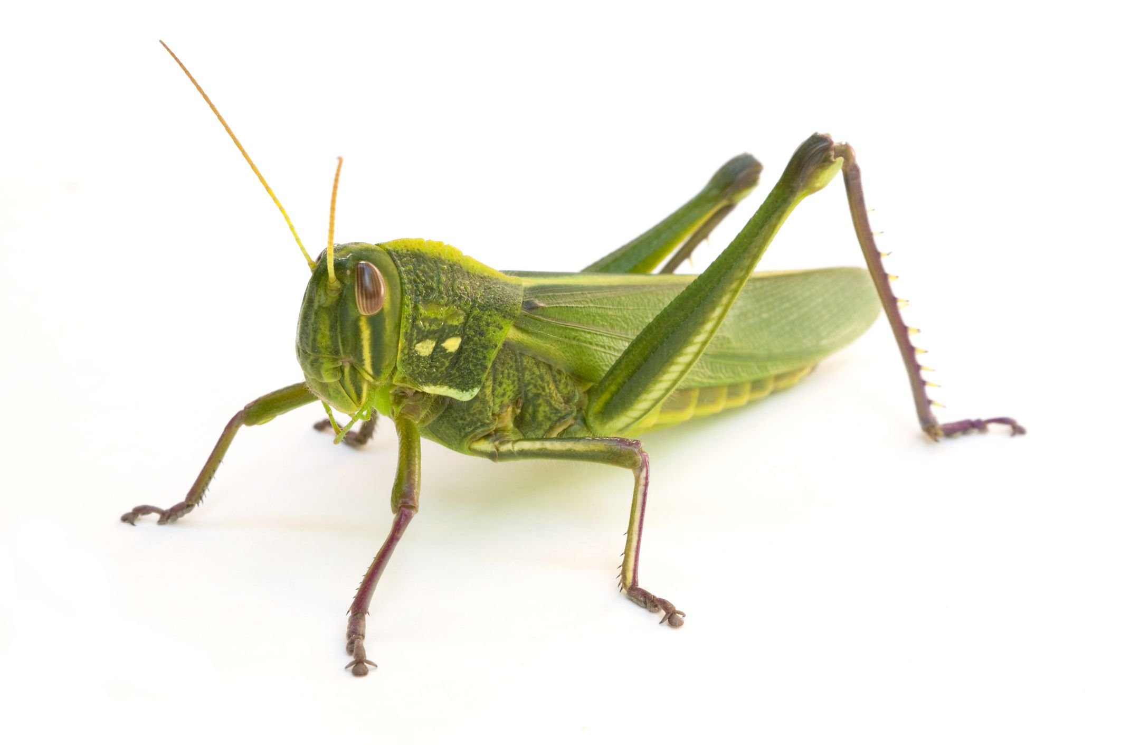
What is your perspective ?
PEST ?
APPETIZER ?
PET ?

Slide 8
International companies have taken note
Source: Hongkong and Shanghai Banking Corporation

Slide 9
My Perspective on the world
Grew up with grandparents living/working overseas
Professional experience working abroad – National University of Singapore
Over the course of my career, specifically sought out opportunities for consultations, projects, presentations, and training initiatives in various international locations

Slide 10
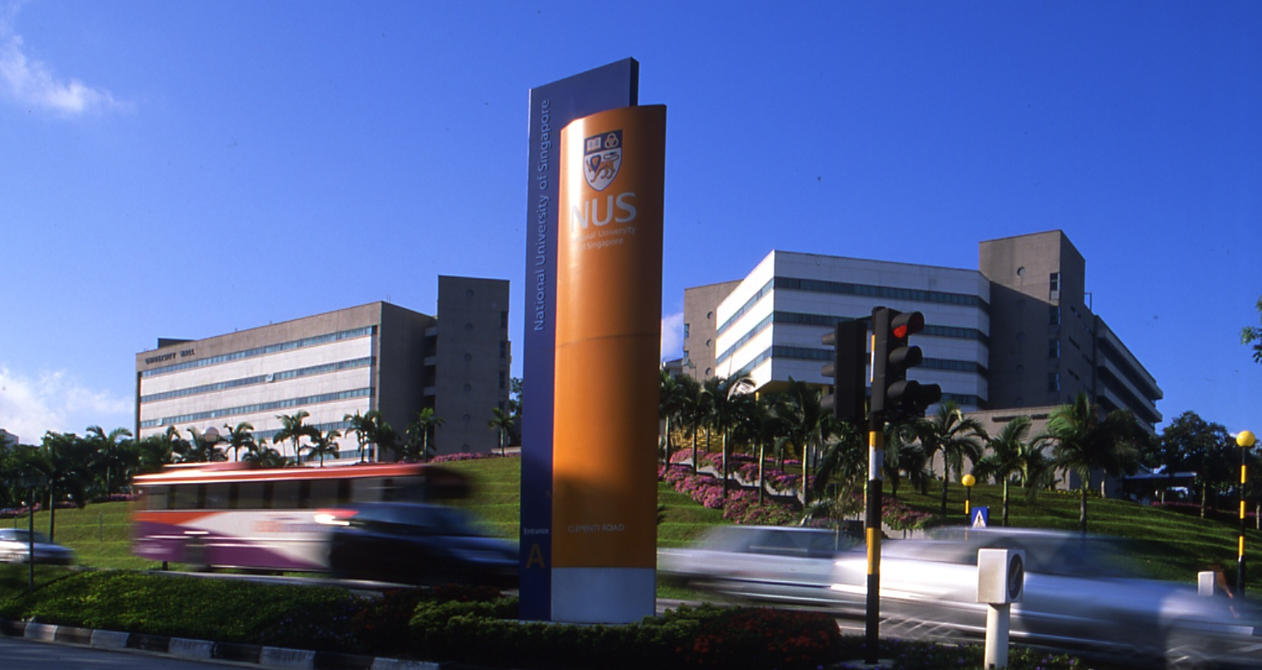
Senior Safety & Health Manager National University of Singapore

Slide 11
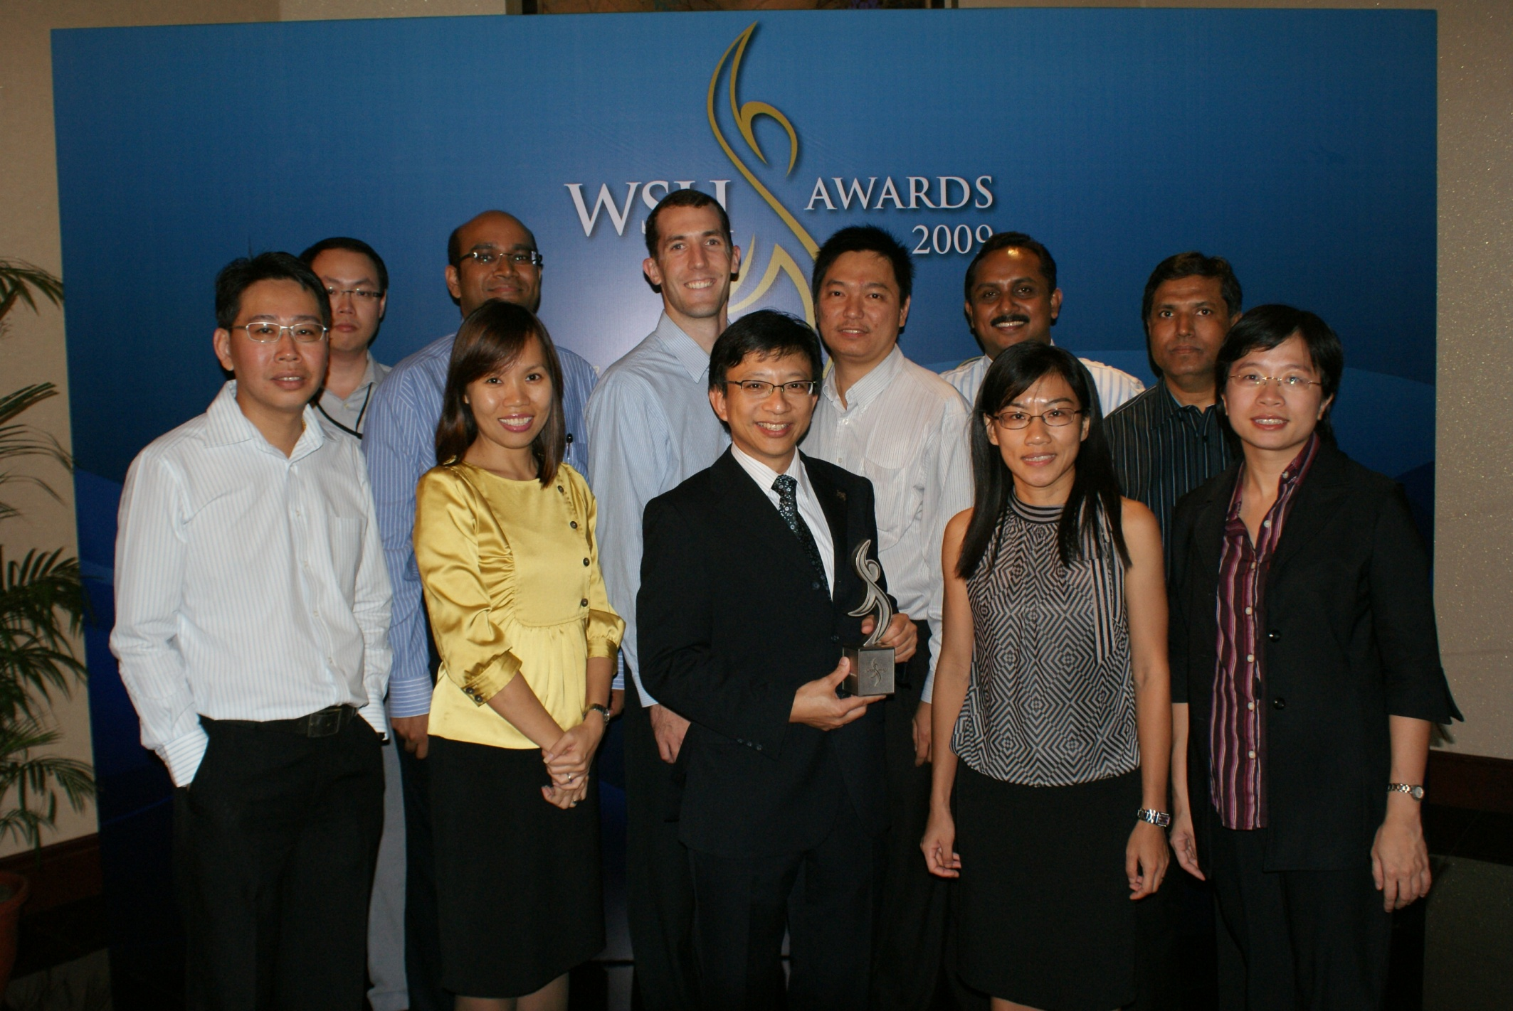
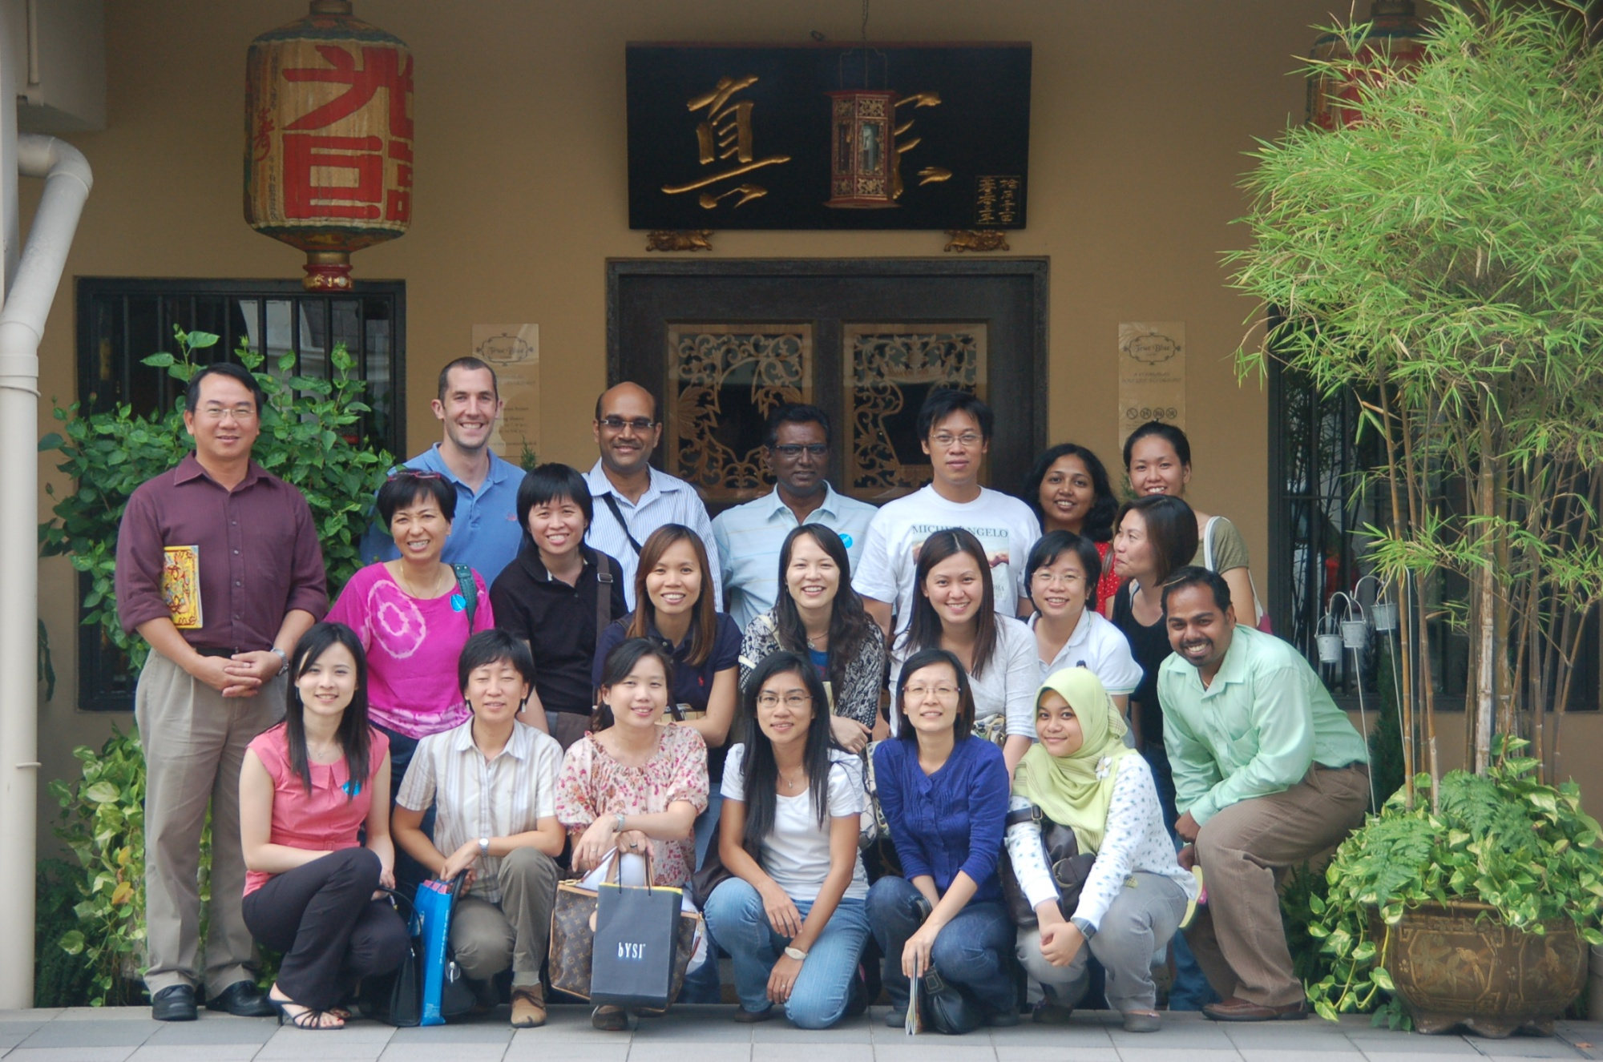
Senior Safety & Health Manager National University of Singapore

Slide 12
Scenarios requiring high level of cultural intelligence
You work for a multinational company with locations in foreign countries
You work for a foreign company with operations in the USA
You work in the USA! Many companies employ people from around the world – and colleges / universities are particularly diverse settings

Slide 13
embracing Diversity in the USA
According to 2016 estimates, 13.2% of US Citizen population is foreign born (42 million of 318 million total population)
Source: US Census Bureau (2018)

Slide 14
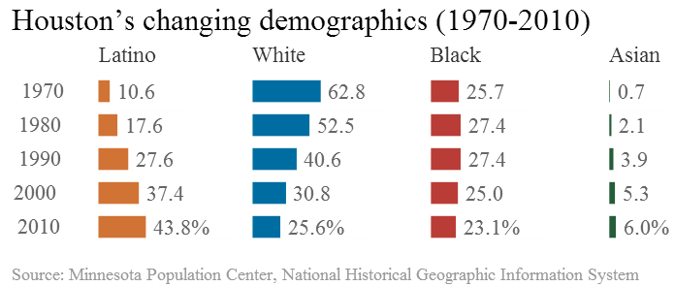
embracing Diversity in Houston
As of 2010, Houston is now considered the most “diverse” city in the USA according to a joint report by the Kinder Institute for Urban Research & the Hobby Center for the Study of Texas

Slide 15
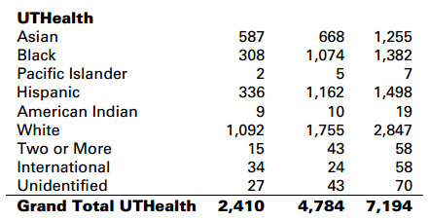
embracing Diversity at UTHealth
Reported Ethnicity of UTHealth Employees:
Source: UTHealth Fact Book (FY2017)

Slide 16
embracing Diversity at UTHealth
Reported Ethnicity of UTHealth Faculty:
Source: UTHealth Fact Book (FY2017)

Slide 17
embracing Diversity at UTHealth
Reported Ethnicity of UTHealth Students:
Source: UTHealth Fact Book (FY2017)

Slide 18
Consider cultural differences
Let’s forget about where people are from for a moment…
Within an organization:
Leadership
Middle managers
Line workers
Distinct differences between departments
– e.g. facilities maintenance personnel, housekeeping,
information technology, security, EHS, etc.

Slide 19
Consider cultural differences
Within a safety department:
We can likely all agree – there are distinct differences between the different disciplines of health and safety
Health physicists, industrial hygienists, biosafety professionals, hazardous waste professionals, risk managers, etc. can be cut from very different fabric, so to speak
Each of us has different educational backgrounds, professional experiences, and expectations for the workplace

Slide 20
Cross-cultural Skills to Consider
Relational skills – whether you enjoy talking and interacting with people from other cultures
Tolerance of uncertainty – whether you are able to tolerate uncertainties, ambiguities and unexpected changes in an intercultural interaction
Adaptability – whether you can change your behavior according to the cultural demands
Empathy – whether you can put yourself in a culturally different person´s shoes and imagine the situation from his or her perspective
Perceptual acuity – whether you understand other people´s feelings and subtle meanings during intercultural interactions
Source: Liao (2015)

Slide 21
Example: Safety Training
“Localization” is required to ensure safety training is effective for a diverse audience
Examples include:
- Training must reflect what worker will see and experience in their own workplaces
- Language differences, but also cultural differences must be considered
- US-centric rules and regulations may not be applicable
- Differences in measurement (imperial versus metric) and temperature (Fahrenheit versus Celsius) may cause confusion
- Driver’s safety training (left versus right hand drive)
Source: Murphy (2018)

Slide 22
Safety Training - suggested Solutions
Localize for language and culture
Ensure consistency of training between geographic locations
Cater to local regulatory requirements
Ensure accessibility of training materials to all workers
Provide the ability to measure results of training efforts
Source: Murphy (2018)

Slide 23
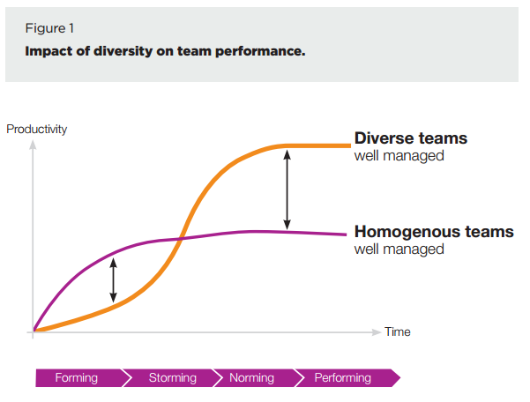
Diversity Trumps Homogeneity
Source: The Inclusive Leader (Korn Ferry Institute)

Slide 24
Diversity and Inclusion as it relates to safety performance

Slide 25
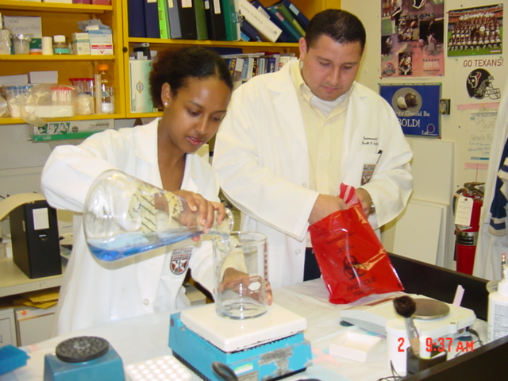
What is your perspective ?

Slide 26
How can we all improve our Cultural intelligence quotient?
The good news is that cultural intelligence can be developed!
Awareness of cultural differences and willingness to understand about other cultures is key
Recognize the potential benefits in both personal and professional life from increased cultural intelligence

Slide 27
How can we all improve our Cultural intelligence quotient?
We can dive into complex theory to understand more about cultural quotient:
Metacognitive – an individual’s cultural consciousness and awareness during interactions with those from different backgrounds
Cognitive – an individual’s knowledge of norms, practices, and conventions in different cultural settings
Motivational – an individual’s capability to direct attention and energy toward cultural differences
Behavioral – an individual’s capability to exhibit appropriate verbal and nonverbal actions when interacting with people from different backgrounds
Source: Ang & Van Dyne, 2015

Slide 28
How can we all improve our Cultural intelligence quotient?
But more practically, go out of your way to:
Understand your own cultural history
Experience different cultures
Learn new languages
Talk to people, listen attentively, and genuinely show interest in different people (plus, as a bonus, most folks like to talk about themselves!)
“There is no substitute for on the ground experience” - Colonel Bernard Banks (retired US Army; associate dean for Leadership Development at Northwestern University’s Kellogg School of Management)

Slide 29
How can we all improve our Cultural intelligence quotient?
Or put another way:
Don’t be afraid to admit you don’t know about other cultures
Suspend judgements
Be empathetic
Systematically check your assumptions
Become comfortable with ambiguity
Celebrate diversity
Source: Quappe and Cantatore, 2018

Slide 30
How can we all improve our Cultural intelligence quotient?
Courses available on UTHealth’s Learn 2 Succeed that you might not know about:
Understanding unconscious bias
Overcoming your own unconscious bias
A manager’s guide to diversity and inclusion
https://www.uth.edu/hr/department/learning-and-development/

Slide 31
How can we all improve our Cultural intelligence quotient?
“Implicit Association Tests” through Project Implicit:
https://implicit.harvard.edu/implicit/takeatest.html

Slide 32
Cultural Dexterity
“Rather than a static learning specific to only one national, ethnic, generational, or other group, cultural dexterity combines cultural knowledge, emotional intelligence, and interpersonal skills that can be adapted to achieve improved business results in any cross-cultural situation.”
Source: Korn Ferry Institute (2012)

Slide 33
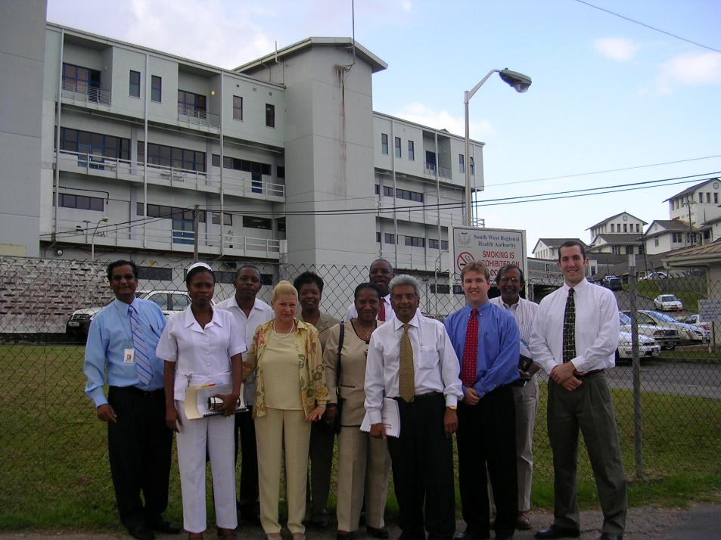
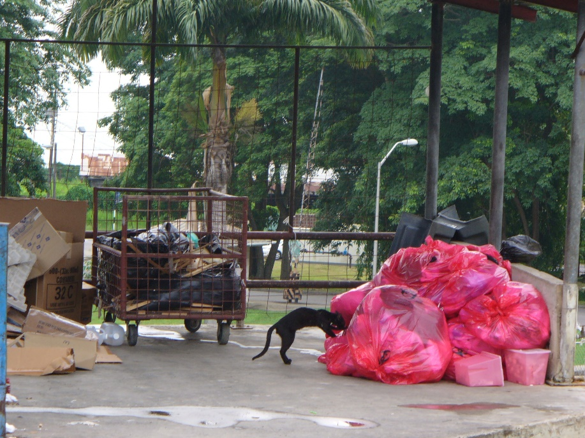
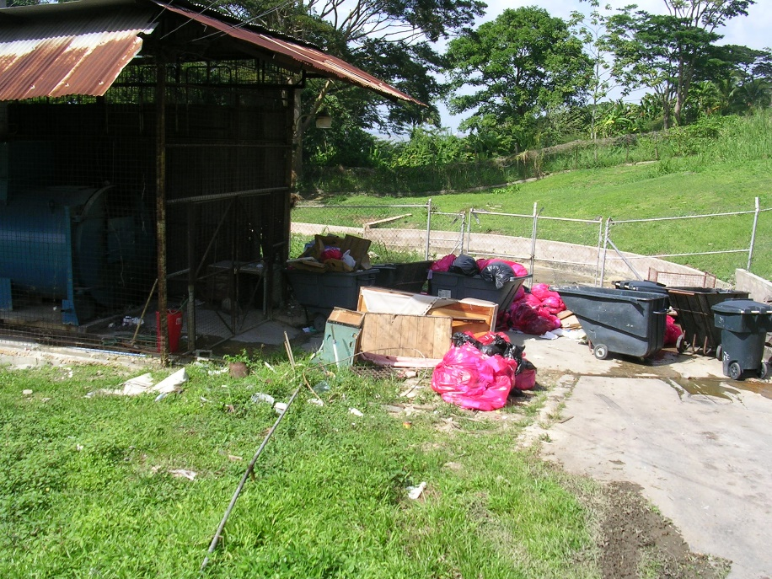
Medical waste management & Healthcare worker Training – Trinidad & Tobago

Slide 34
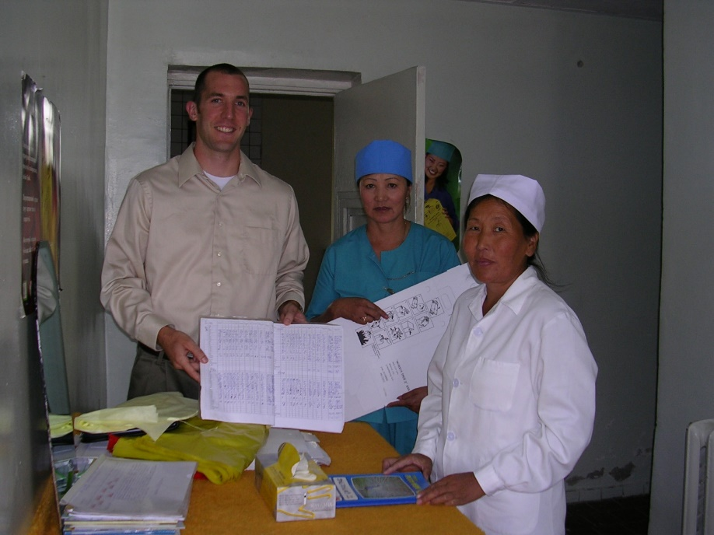
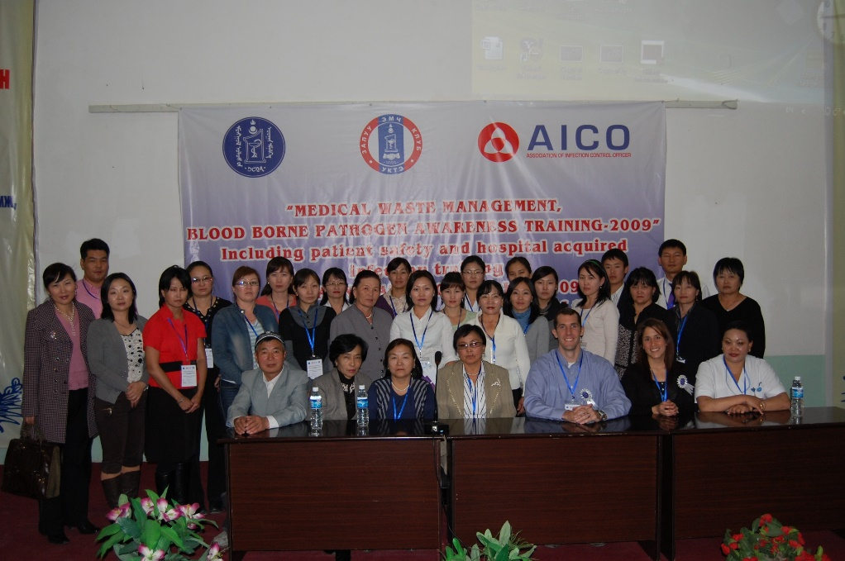
Medical waste management & Healthcare worker Training – Mongolia

Slide 35
References
Ang, S, Dyne, LV. Handbook of cultural intelligence: Theory, measurement, and applications. Armonk: Routledge, 2015.
Carpenter-Song, EA, Schwallie, MN, Longhofer, J. Cultural Competence Re-Examined: Critique and Directions for the Future. Psychiatric Services, 58(10), 1362-1365.
Earley, PC, Mosakowski, E. Cultural Intelligence. Harvard Business Review, October 2004.
Flynn, MA, Castellanos, E, Flores-Andrade, A. Safety Across Cultures: Understanding the Challenges. Professional Safety, January 2018.
Korn Ferry Institute. The Inclusive Leader: Optimizing Diversity by Leveraging the Power of Inclusion (2016). Accessed online: https://dsqapj1lakrkc.cloudfront.net/media/sidebar_downloads/Korn-Ferry-Institute-The-inclusive-leader.pdf
Liao, EY. Why You Need Cultural Intelligence (And How To Develop It). Forbes, March 2015. Accessed online: https://www.forbes.com/sites/iese/2015/03/24/why-you-need-cultural-intelligence-and-how-to-develop-it/#5ccdb68317d6
Murphy, S. International Safety Training: Preparing a Global Workforce. Professional Safety, February 2018.
Quappe, S, Cantatore, G. What is Cultural Awareness Anyways? Accessed online: http://www.culturosity.com/articles/whatisculturalawareness.htm#_ftnref1

