Slide 1
Discovering the World of “Digital Safety”: Amazing Tools Available at Your Fingertips That You Might Not Have Known About
Scott Patlovich, DrPH, CIH, CSP, CBSP, SM(NRCM), CHMM, CPH
Assistant Vice President, Environmental Health and Safety
The University of Texas Health Science Center at Houston
Adjunct Instructor, The University of Texas School of Public Health
Scott.J.Patlovich@uth.tmc.edu
713 500 8100

Slide 2
Digital Safety
What we ARE going to talk about:
Digital safety tools available for health and safety professionals
What we are NOT going to talk about:
Digital safety as it relates to cybersafety for kids/teens (a common use of the term - try “Googling” it)
Notes:
Audience feedback

Slide 3
Disclaimer
I am here to share helpful tools with other health and safety professionals
Unless otherwise specified, the apps discussed are available for free
I am not here to endorse any particular product
I do not receive any perks from any company regarding the use of their products
I’m not technically a technical guy
This list is not all inclusive – your list may vary – and we welcome your input and feedback
Notes:
Solicit audience feedback on apps they may use and find useful

Slide 4
The term “App”
“According to the Oxford English Dictionary’s historical entry for the word, ‘app’ as a shortening of application (as in application program) first found its way into print in the 1980s. Back then it was mainly a colloquial term used in computing circles…”
With the introduction of the iPhone in 2007, and subsequently the Apple App Store in 2008, thousands of ‘apps’ were made available and were downloaded millions of times
“App” was awarded the “word of the year” by the American Dialect Society in 2010
http://www.americandialect.org/app-voted-2010-word-of-the-year-by-the-american-dialect-society-updated

Slide 5
Appreciating The Digital Divide
Younger EHS professionals may be privy to these technologies, however the “more senior” generation may not have considered or embraced them
Don’t assume all EHS professionals know about these apps or, importantly, know how to access or use them

Slide 6
Health and Safety Apps
How many currently use apps in your professional practice?
Which ones do you find most useful?

Slide 7
Survey of EHS Professionals
This is not just Scott’s list!
Practicing EHS professionals from around the USA were queried to obtain feedback on use of health and safety related apps
The following represents a summary of the feedback obtained

Slide 8
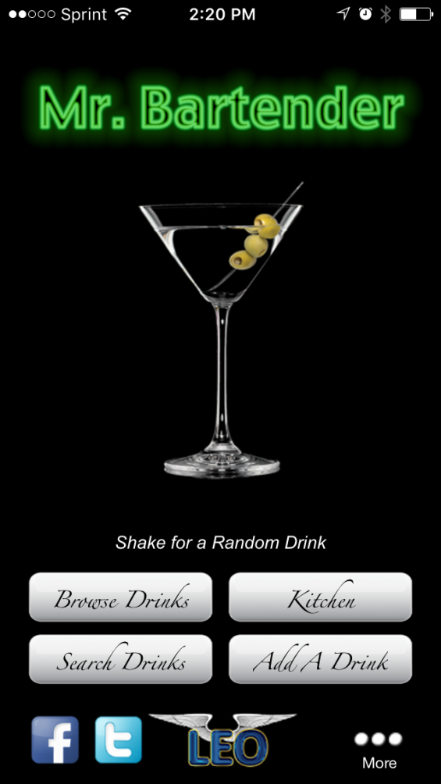
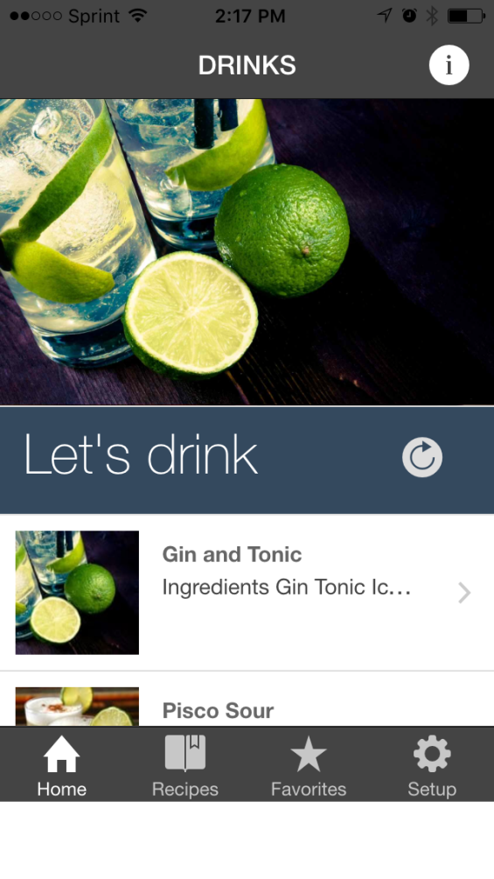
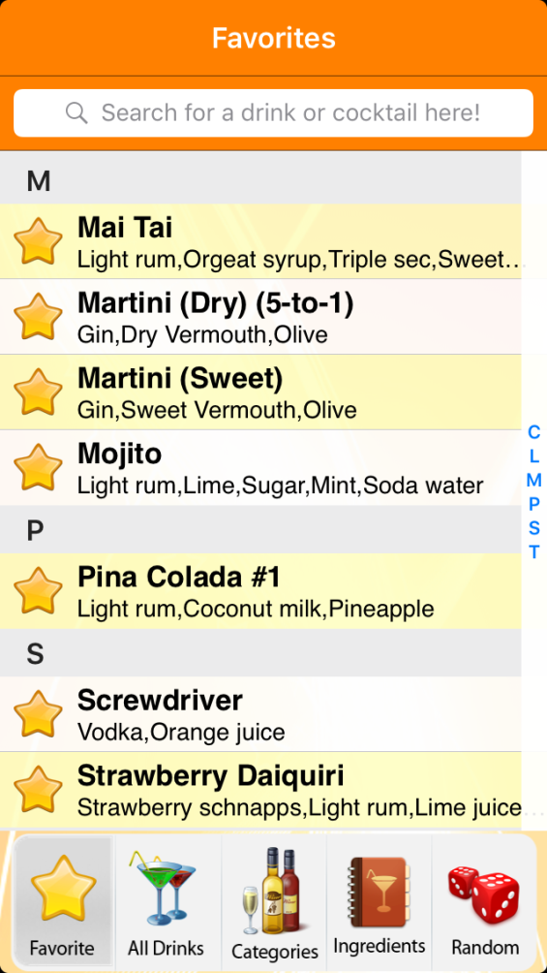
Top Three Responses

Slide 9
Weather Apps
Why the need for real time weather information?
Based on National Weather Service and Associated Press reports, approximately 140 deaths have been attributed to flooding in 2016.
Texas has had the highest number of flood deaths with at least 77 related fatalities during 2015-2016. (8 in Houston in April 2016)
Notes:
Weather App Logos.
AccuWeather
The Weather Channel
Yahoo Weather
References:
https://www.wmo.int/pages/prog/arep/wwrp/new/wwosc/documents/WWOSCweatherandhealth.pdf
National Weather Services (NWS)
The Weather Channel
http://cyberguy.com/appearances/6-weather-apps-that-could-save-your-life/

Slide 10
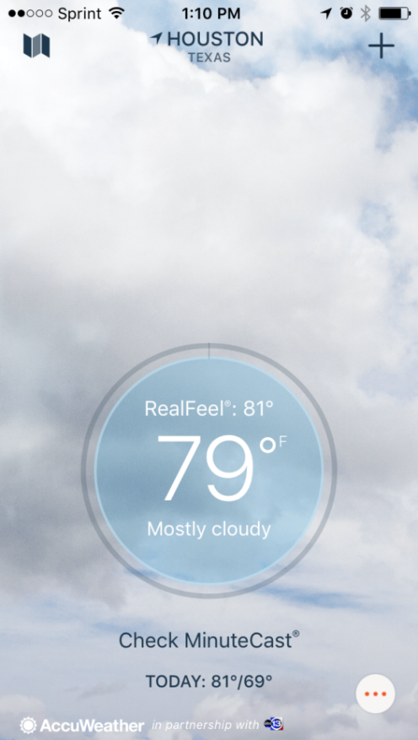
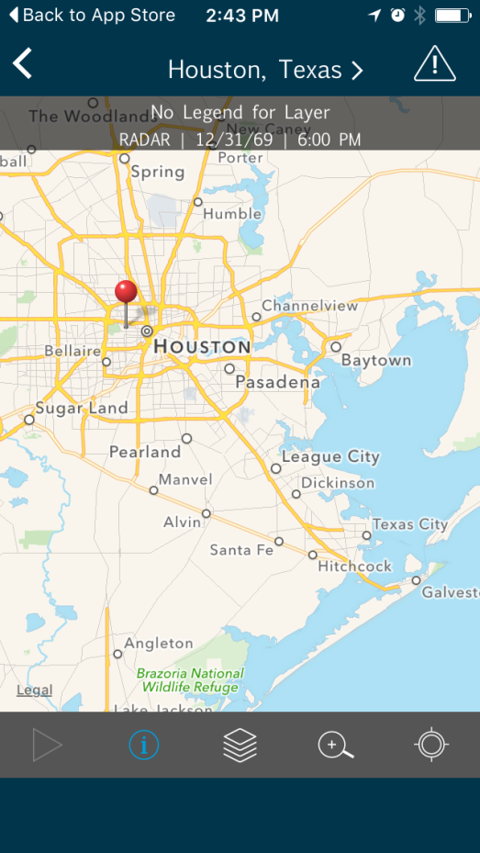
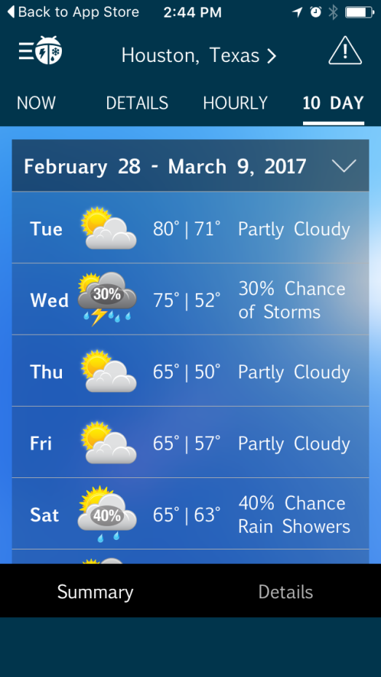
Weather Apps
Helpful for planning common daily activities
Can be used to guide emergency planning decisions
In case of severe weather, these apps also inform the users about how to protect themselves and minimize damage
Notes:
Public health Impact
Historical trends and future predictions help frame the issue, and the data can be used to guide emergency planning decisions.
Also, Can help the common people make decisions about daily activities and plan their day accordingly.
In case of severe weather, these apps can help show the users how to protect themselves and what measures can be taken to minimize the damage.

Slide 11
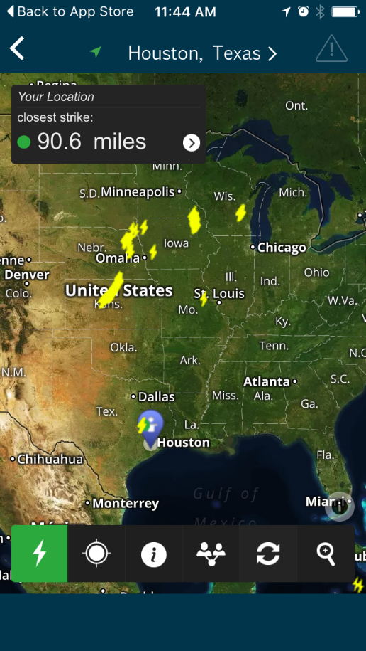
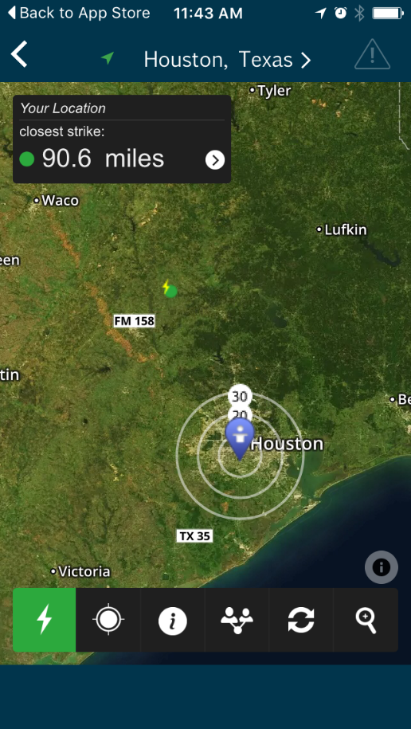
Lightning Strike Alerts
Many lightning strike alert apps exist
Spark-Alert from WeatherBug provides real time lightning strike info for your area

Slide 12
Niosh ladder safety
Why is ladder safety so important?
More than 500,000 people are injured and more than 300 people die from ladder-related injuries each year in the United States.
The estimated annual cost of ladder injuries in the US is $24 billion, including lost work time, medical, legal, and pain/suffering expenses.
Notes:
Reference: https://www.cdc.gov/niosh/topics/falls/mobileapp.html

Slide 13
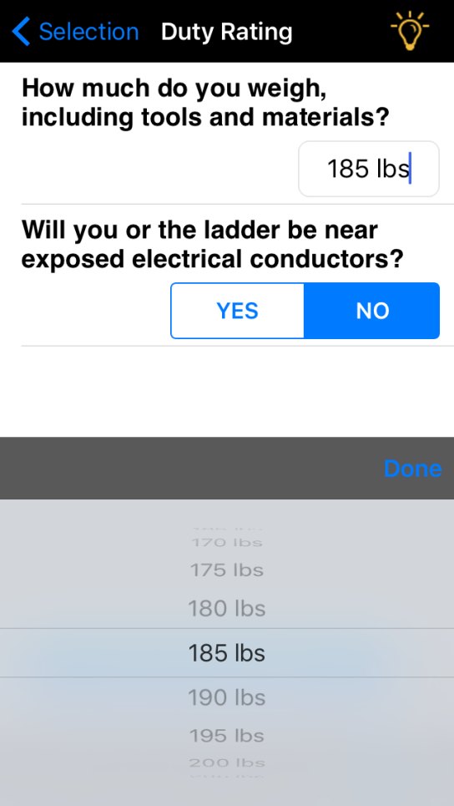
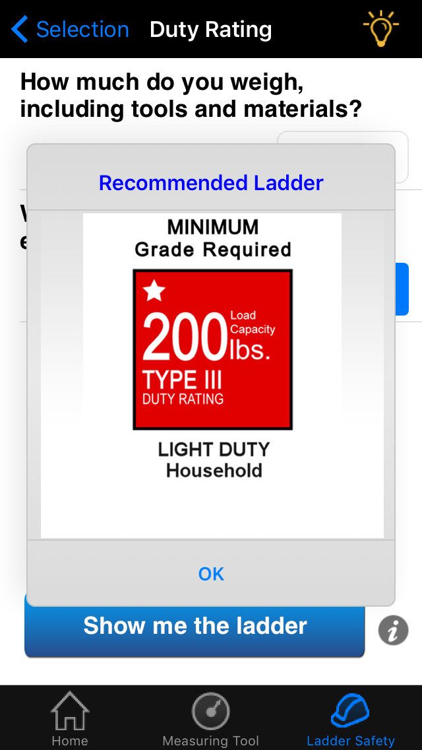
NIOSH Ladder Safety
Determine what ladder rating is appropriate:
Notes:
NIOSH LADDER SAFETY MONTH – MARCH! To raise awareness of ladder safety and to decrease the number of ladder related injuries and fatalities. Every year over 300 people die in ladder-related accidents, and thousands suffer disabling injuries.
http://www.americanladderinstitute.org/page/laddersafetymonth

Slide 14
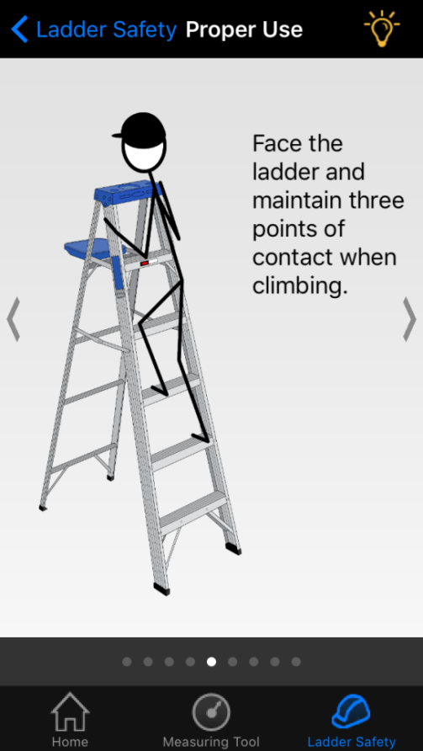
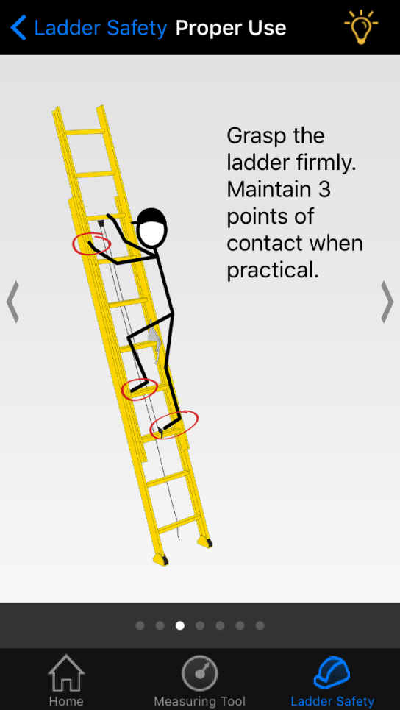
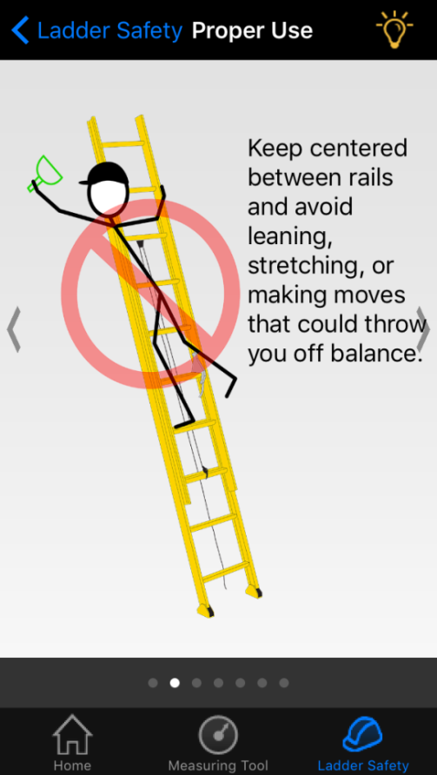
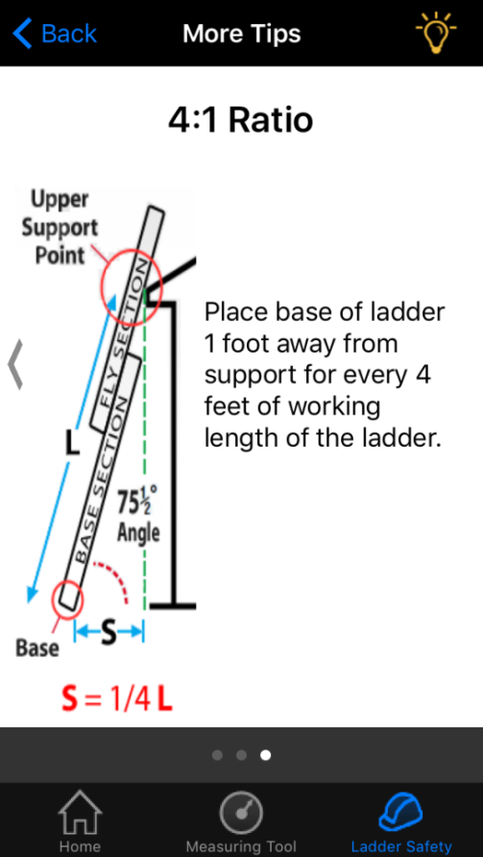
NIOSH Ladder Safety
Provides basic but important ladder safety information:

Slide 15
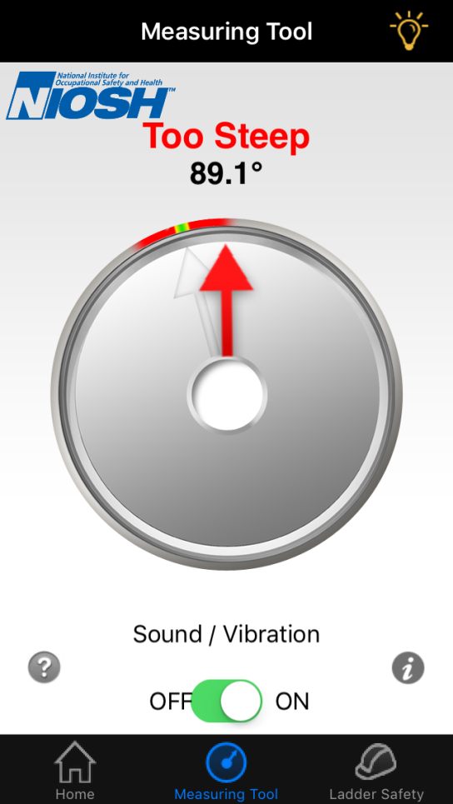
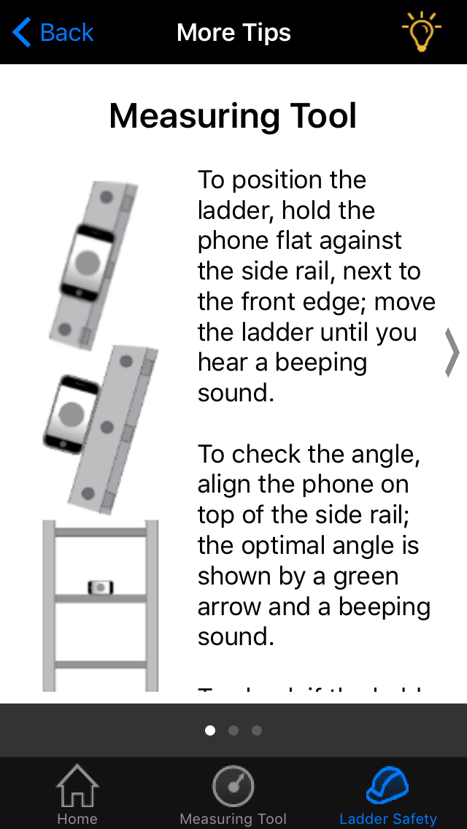
NIOSH Ladder Safety
Ladder safety measuring tool included:
Notes:
Include short video if possible

Slide 16
NIOSH Ladder Safety
Short video demonstrating the NIOSH Ladder Safety Tool:
Notes:
Include short video if possible

Slide 17
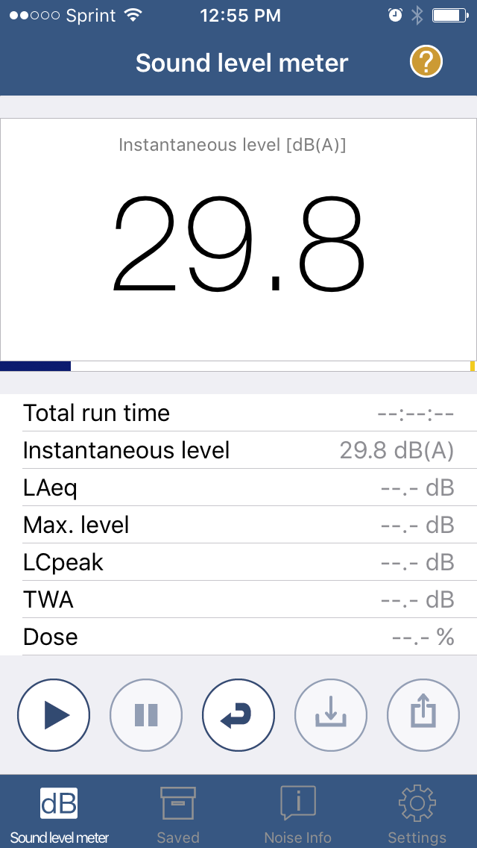
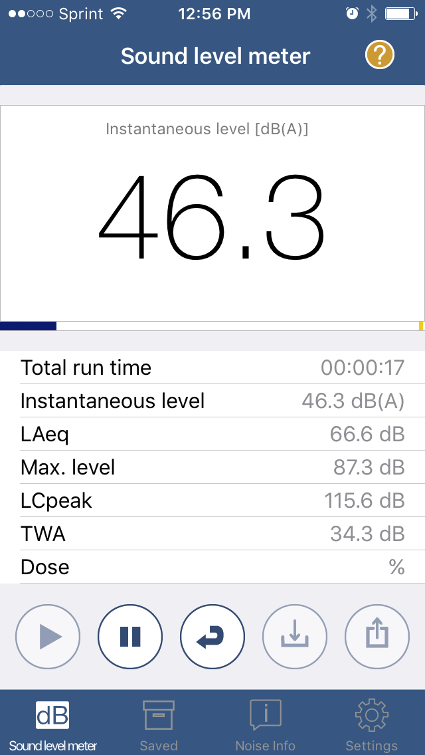
NIOSH Sound Level Meter
Real-time sound level measurements, with logging feature:
Notes:
Scientists and occupational safety and health professionals could rely on such shared data to build job exposure databases and promote better hearing health and prevention efforts. The ability to acquire and display real time noise exposure data could help raise workers’ awareness about their work environment and help them make informed decisions about potential hazards to their hearing.
https://blogs.cdc.gov/niosh-science-blog/2017/01/17/slm-app/

Slide 18
NIOSH Sound Level Meter
Peer reviewed literature evaluating this app:
Chucri A. Kardous and Peter B. Shaw, Evaluation of smartphone sound measurement applications, The Journal of the Acoustical Society of America Vol. 135, Iss. 4, 2014
Chucri A. Kardous and Peter B. Shaw, Evaluation of smartphone sound measurement applications (apps) using external microphones—A follow-up study, The Journal of the Acoustical Society of America Vol. 140, Iss. 4, 2016
Benjamin Roberts, Chucri Kardous, and Richard Neitzel, Improving the accuracy of smart devices to measure noise exposure, Journal Of Occupational And Environmental Hygiene Vol. 13 , Iss. 11, 2016

Slide 19
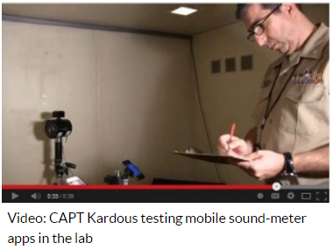
NIOSH Sound Level Meter
From a recent NIOSH Science Blog on this topic:
This follow-up study suggests that using external, calibrated, microphones greatly improves the overall accuracy and precision of smartphone sound measurements, and removes much of the variability and limitations associated with the built-in smartphone microphones.

Slide 20
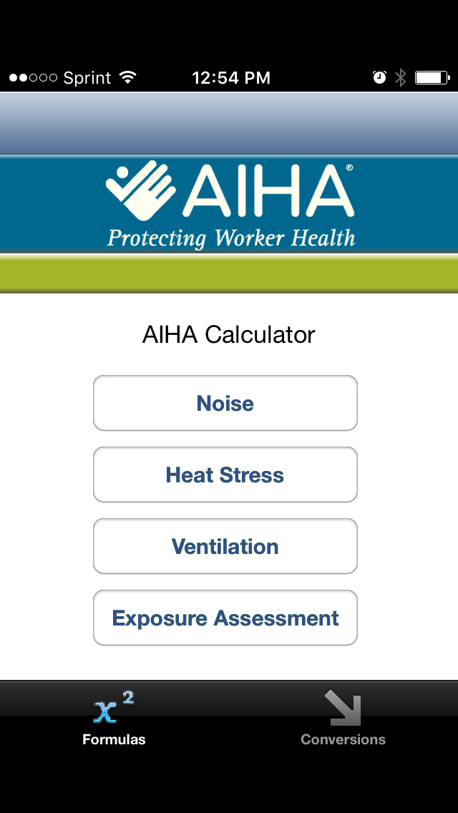
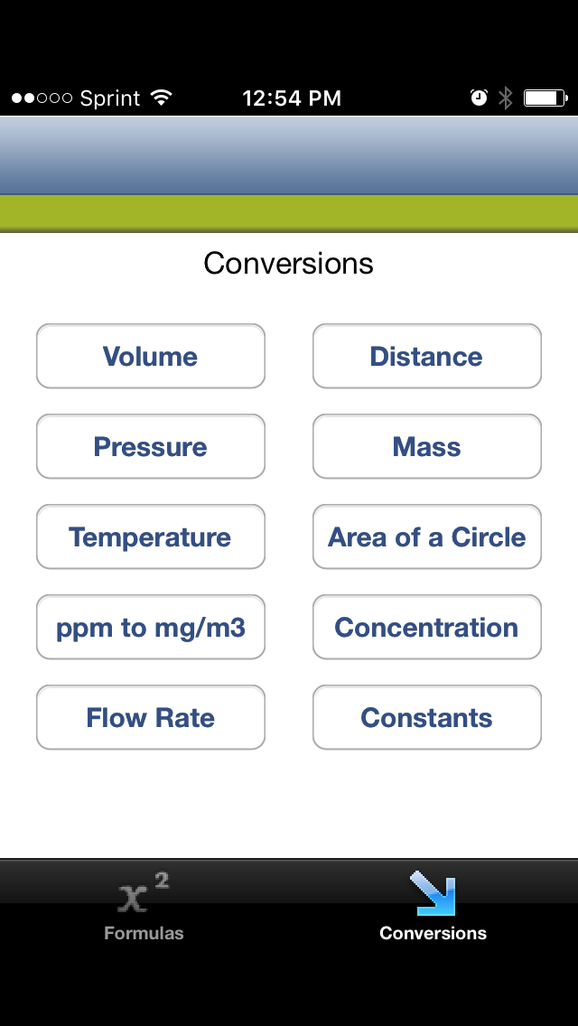
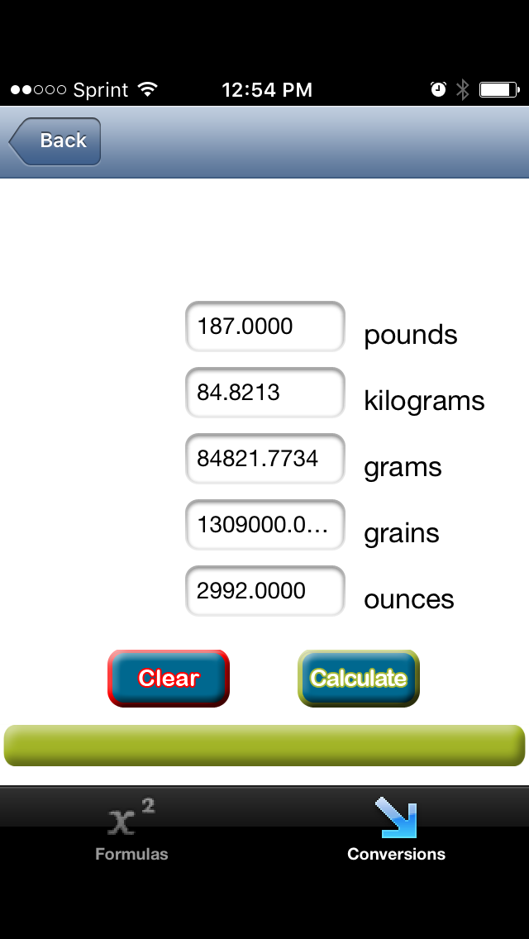
AIHA IH Calculator
Helpful calculations and conversions for Industrial Hygienists and for everyday life:
Notes:
Math sucks! This App would make everyone’s life better!

Slide 21
OSHA HEAT INDEX CALCULATOR
Why is understanding heat stress so important?
Heat is one of the leading weather-related causes of death in the United States, resulting in hundreds of fatalities each year and even more heat-related illnesses.
In 2014, 2,630 workers suffered from heat illness and 18 died from heat stroke or related causes on the job.
Notes:
Heat illnesses and deaths are preventable.

Slide 22
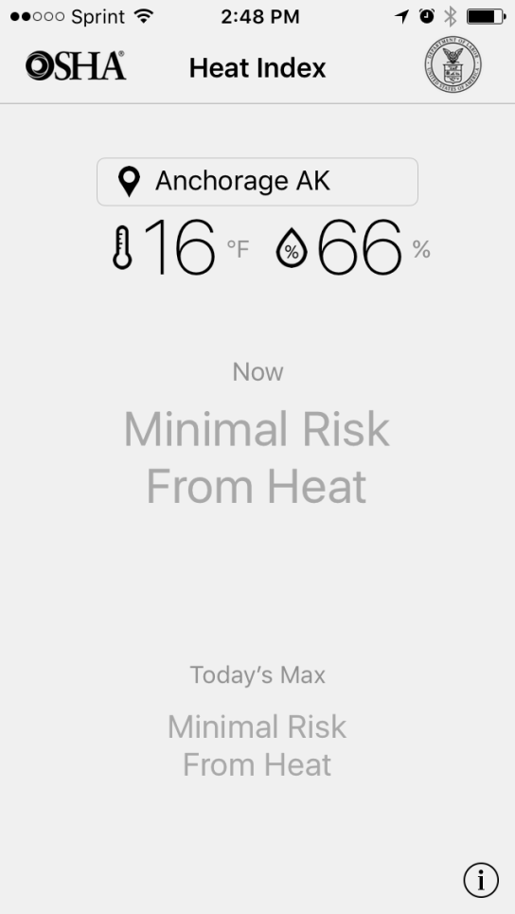
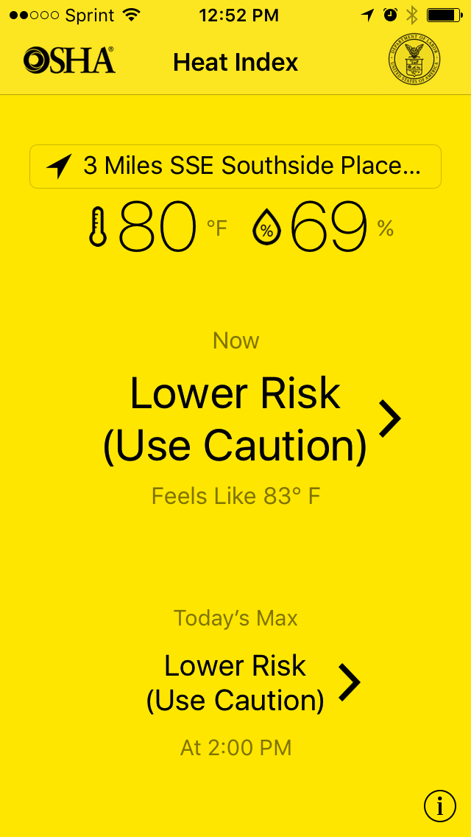
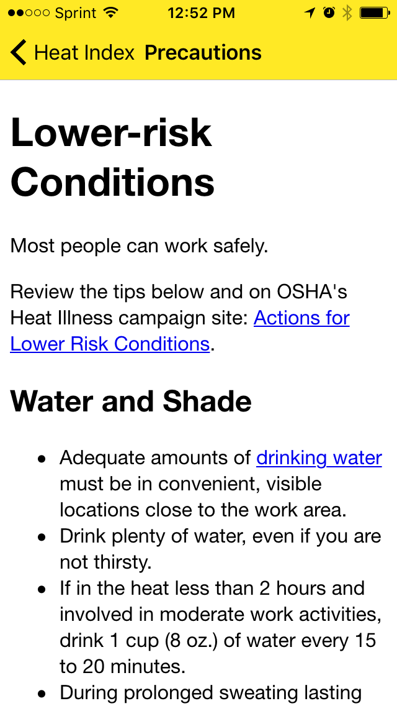
OSHA Heat Index Calculator
Occupational Safety and Health Administration
Notes:
The App allows workers and supervisors to calculate the heat index for their worksite, and, based on the heat index, displays a risk level to outdoor workers. Then, with a simple tap, you can get reminders about the protective measures that should be taken at that risk level to protect workers from heat-related illness—reminders about drinking enough fluids, scheduling rest breaks etc.
http://www.nws.noaa.gov/os/heat/
https://www.osha.gov/SLTC/heatillness/index.html?utm_source=Twitter

Slide 23
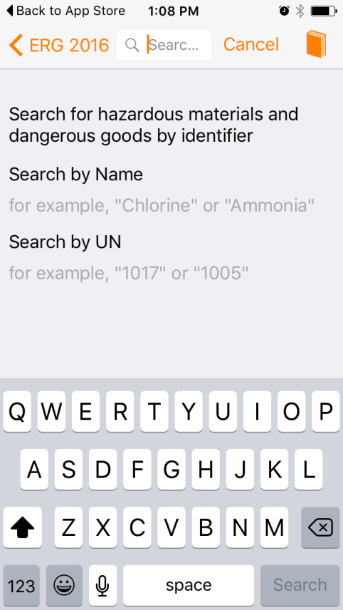
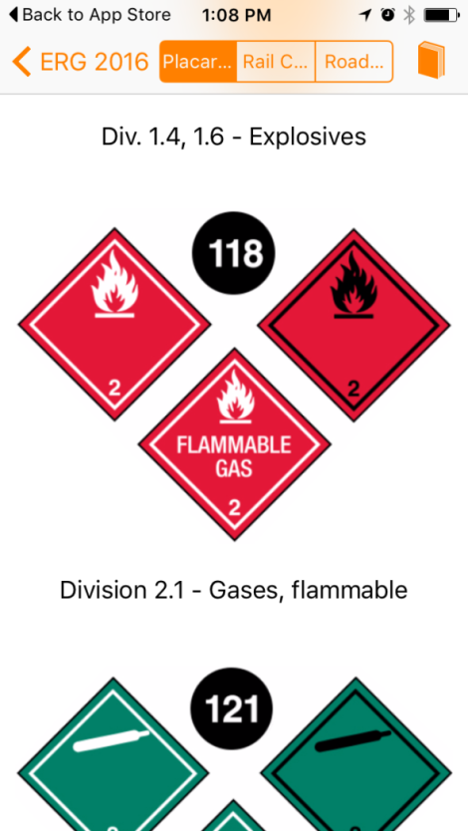
Emergency Response Guide (2016)
North American Emergency Response Guide (Pipeline and Hazardous Materials Safety Administration)
Guidance for hazardous materials transportation emergency response
Notes:
Browsing through this App user comments, everyone had one common comment ‘It’s handy, better than a book’. Everyone carries a cell phone, so it is easy to look up the chemicals and the numbers quickly. Fast, easy to access information to help manage hazardous materials incidents.

Slide 24
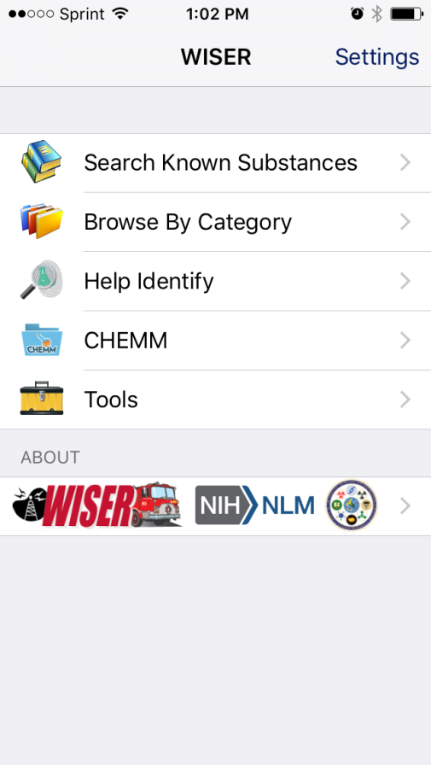
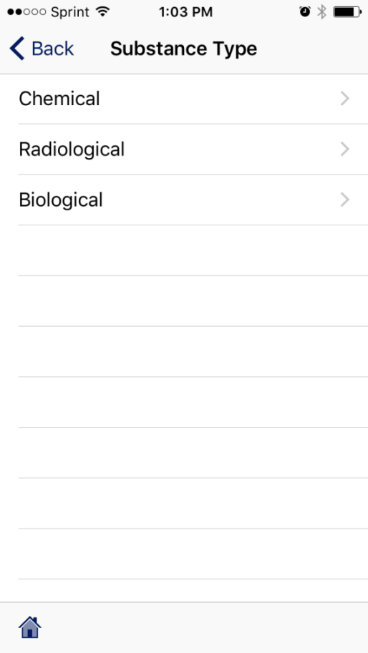
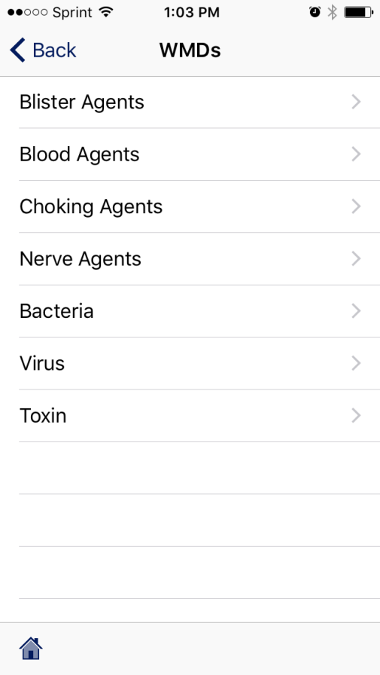
WISER
WISER = Wireless Information System for Emergency Responders (U.S. National Library of Medicine)
Notes:
This App will help the emergency responders and also the general public in times of heightened public health awareness due to Hazmat situations.

Slide 25
PEDSAFE
Why is pedestrian safety so important?
Approximately 5,000 pedestrians are killed and approximately 70,000 are injured in traffic related incidents each year in the United States.

Slide 26
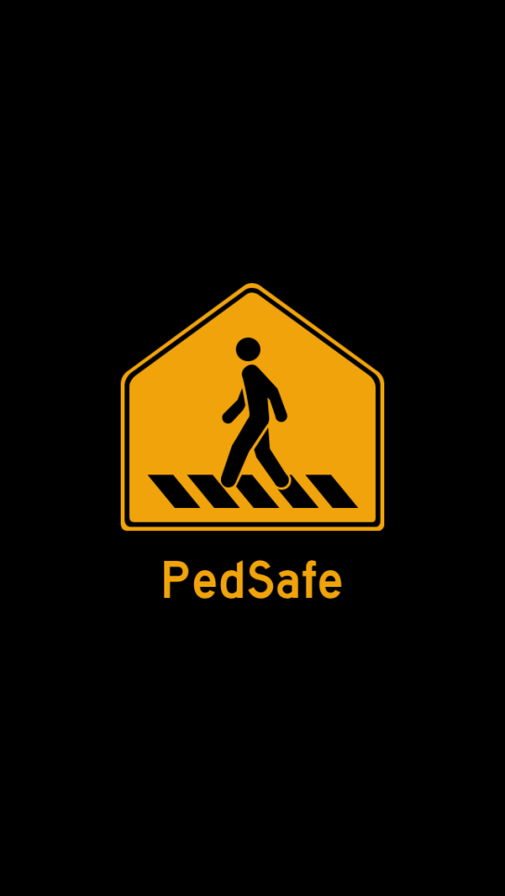
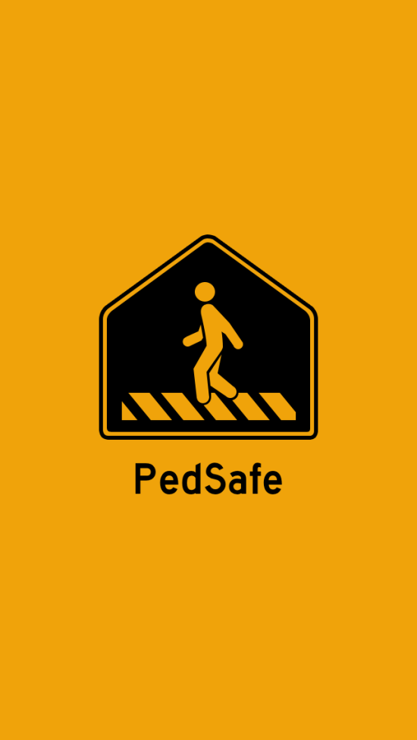
PEDsafe
Flashing yellow light to provide safety for pedestrians at night
Notes:
The PedSafe app assists pedestrians to be proactive and alert when crossing or walking near streets and roadways. It helps improve drivers' awareness by increasing your visibility. Becoming more noticeable while walking can help make everyone safer.
Every one is a pedestrian and needs to be able to travel safely and provided accessibility.
https://www.fhwa.dot.gov/research/deployment/pedsafe.cfm

Slide 27
PedSafe
Short video demonstrating the PEDSAFE app:
Notes:
Include short video if possible

Slide 28
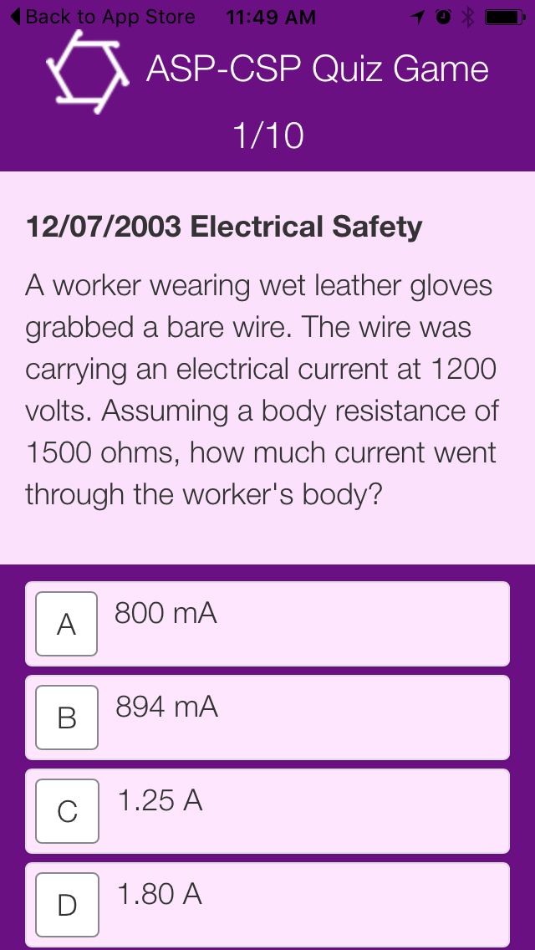
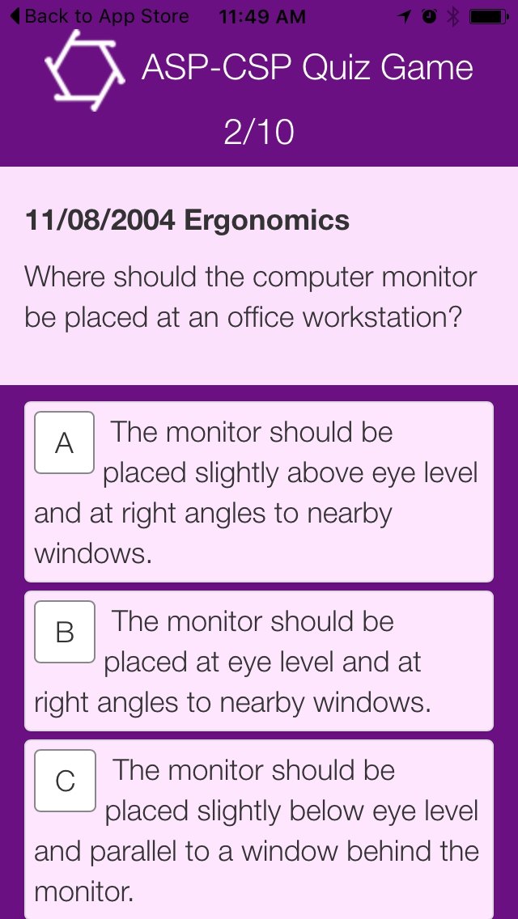
Exam Prep Apps
Studying for a credentialing exam? Try an app!
Example: ASP-CSP Quiz Game (Bowen EHS)

Slide 29
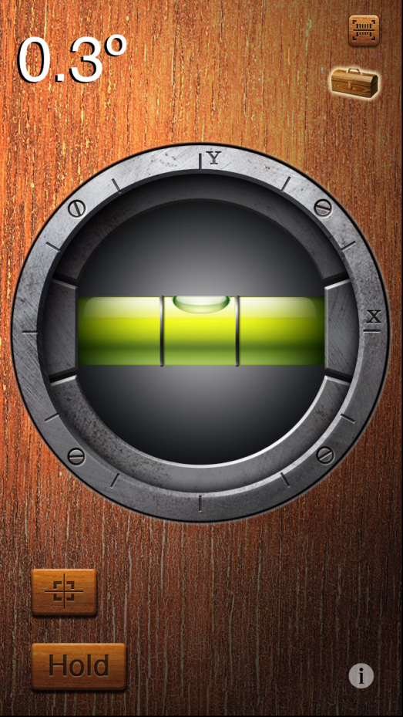
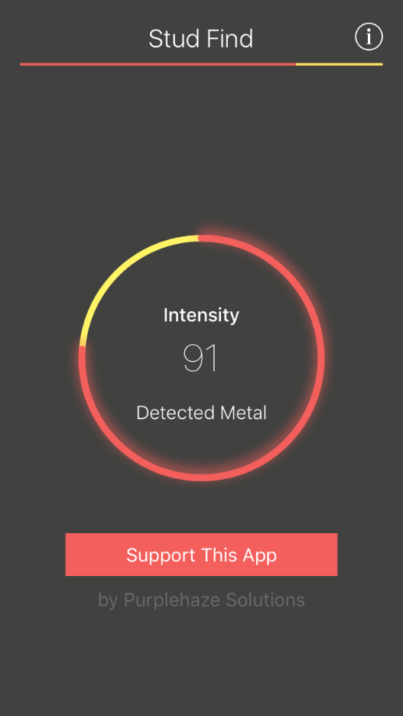
Other helpful tools
iHandy level and other carpenter’s tools
Studfinder

Slide 30
Needs assessment
Would a hands-on workshop with “younger” technologically savvy individuals be helpful?
Are there apps that we haven’t considered?
What other apps could be useful to the EHS profession for future development?

Slide 31
Summary
Health and safety related apps are readily available at your fingertips
Many of them are free of charge
Spend some time populating your device to make it a useful tool in the workplace
Be aware of the potential limitations to these apps
Share good apps with your peers!
Notes:
Cool App alert
Apps like Tornado by American Red Cross is one of the most used Apps in the tornado prone areas. This app when installed will monitor your location for danger of a tornado. The warning alarm activates automatically. This app helps to get you educated on how to prepare before a big storm and what to do immediately following a tornado disaster.

Slide 32
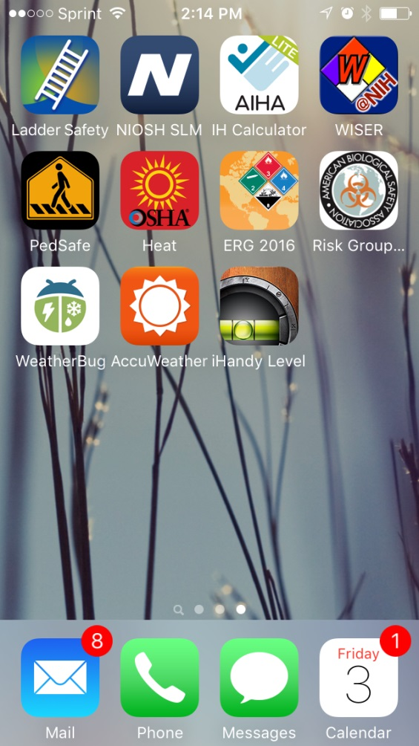
Thank you!
You know this smart phone belongs to a safety geek……

Slide 33
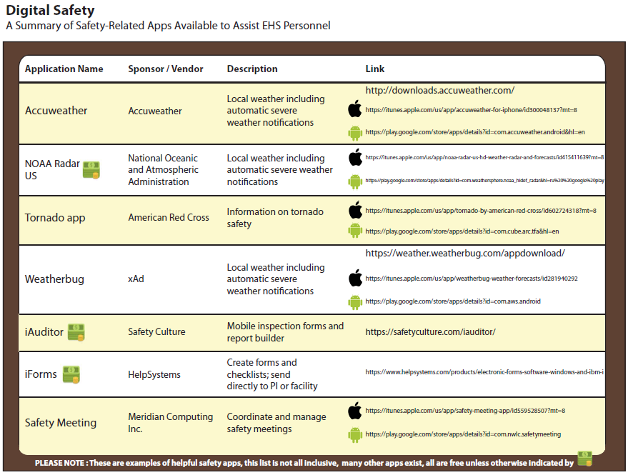
References
See handout created by Scott Patlovich

