Slide 1
Those Annoying Backup Alarms, is there a better solution?
Rick Kilpatrick, Ph.D., CSP
Corporate Health & Safety Manager
Shurtape Technologies, LLC
Western Carolina Chapter, ASSP

Slide 2
OSHA Requirements – Polling Question
Is there an OSHA requirement for reversing/backup alarms within the general industry standards, 29 CFR Part 1910 ?

Slide 3
OSHA Requirements
“As you may be aware, OSHA has no requirements for back-up alarms in the general industry standards, 29 CFR Part 1910.”
29 CFR Part 1926.601(b)(4) of the Construction Safety and Health Regulations entitled Motor vehicles requires:
“(4) No employer shall use any motor vehicle equipment having an obstructed view to the rear unless:
(i) The vehicle has a reverse signal alarm audible above surrounding noise level or;
(ii) The vehicle is backed up only when an observer signals that it is safe to do so."
“As you can see, the alarm is only required when vision to the rear of the operator is obstructed and the operator lacks an observer to signal him. It would be the employer's obligation to determine the noise level in his particular worksite and select an appropriate alarm if he chooses to use it.”
Regulations for back-up alarms. (n.d.). Occupational Safety and Health Administration. https://www.osha.gov/laws-regs/standardinterpretations/1980-07-11#:~:text=The%20regulation%20you%20refer%20to,is%20safe%20to%20do%20so.%22

Slide 4
OSHA Requirements
A second regulation, 29 CFR Part 1926.602(a)(9), entitled Material Handling Equipment states:
"(9) Audible alarms
(i) All bidirectional machines, such as rollers, compactors, front-end loaders, bulldozers, and similar equipment, shall be equipped with a horn, distinguishable from the surrounding noise level, which shall be operated as needed when the machine is moving in either direction. The horn has to be maintained in operative condition.
(ii) No employer shall permit earthmoving or compacting equipment which has an obstructed view to the rear to be used in reverse gear unless the equipment has in operation a reverse signal alarm distinguishable from the surrounding noise level or an employer signals that it is safe to do so."
Regulations for back-up alarms. (n.d.). Occupational Safety and Health Administration. https://www.osha.gov/laws-regs/standardinterpretations/1980-07-11#:~:text=The%20regulation%20you%20refer%20to,is%20safe%20to%20do%20so.%22

Slide 5
Backup Alarms

Slide 6
Function of a Backup Alarm?
Address route cause of reversing accidents:
person unaware they were in danger
driver could not see the person
driver did not notice the person
driving carelessly or recklessly
person careless or reckless
Federal Mine Safety & Health Review Commission Civil Penalties Proceeding report 2011:
“The obvious purpose of a back-up alarm is to warn persons positioned behind the truck who cannot be seen by the truck operator.”
Function: to protect someone
at risk (in hazard area) &
unseen by driver

Slide 7
Tonal Backup Alarms
Implemented in 1971 by Army Corps of Engineers
Tonal alarms are ubiquitous
30 years later, research shows that tonal alarms installed by the original equipment manufacturers failed to prevent over 66% of the backover accidents they investigated.
Purswell, J. P., & Purswell, J. L. (2001). The effectiveness of audible backup alarms as indicated by OSHA accident investigation records. In A.C. Bittner, P.C. Champney, & S.J. Morrissey (Ed.), Advances in Occupational Ergonomics and Safety (pp. 444-450). Amsterdam, Netherlands: IOS Press.

Slide 8
Backover Fatalities; 2007-2018
Backover fatalities in North America, 2007 to 2018. Adapted from the Bureau of Labor Statistics Occupational injuries and illnesses and fatal injuries profiles, 2019. Retrieved from https://data.bls.gov/gqt/ProfileCharacteristics; reversing vehicle excluding highway work zones and roadway events.

Slide 9
Tonal Reversing Alarms Weaknesses
noise pollution / complaints
intentional disconnects
fright –> freeze reaction
multiple alarms in immediate area can create confusion
site-worker hearing loss at the tonal alarm’s frequency
hearing protection use
site noise frequencies masking tonal alarm’s frequency
ignoring (tuning out) alarm (tonal alarm high false alarm rate)

Slide 10
Broadband Reversing Alarms

Slide 11
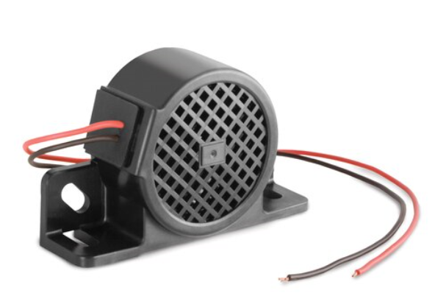
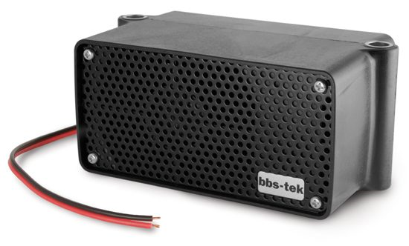
Broadband Alarms
BBS–77 (77 dBA)
SA-BBS-97 (range77-97dBA)
BBS-102 (102 dBA)
SA-BBS-107 (range 87-107dBA)
Notes:
History & Alarm sample

Slide 12
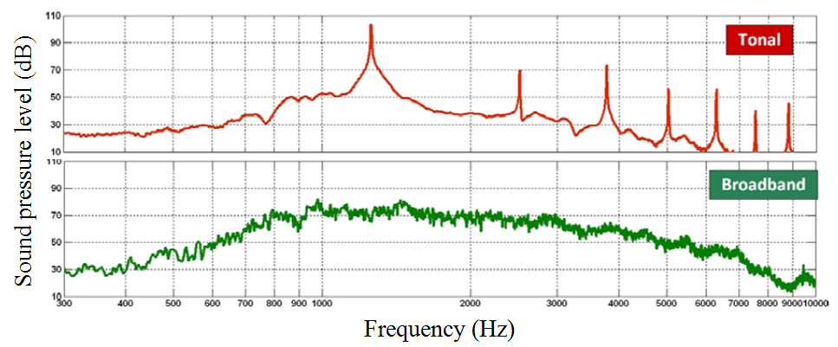
Frequency Content: Tonal v. Broadband
.Frequency content of a tonal and broadband alarm. Reprinted from “Comparison of different vehicle backup-alarm types with regards to worker safety” by Nelisse, Laroche, Giguere, Boutin, Vaillancourt, & Laferriere, 2011, p.280. Copyright 2011 by ICBEN.

Slide 13
Broadband Alarm Strengths
directional audio output across many frequencies
sound is distinguishable
distinguishable in location
distinguishable in direction of travel
can typically operate at 5 dB(A) less than tonal alarms
less pollution as sound is more readily absorbed by the air
Self-adjusting output (optional)

Slide 14
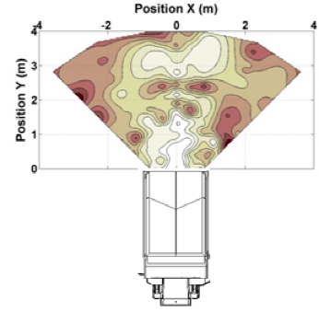
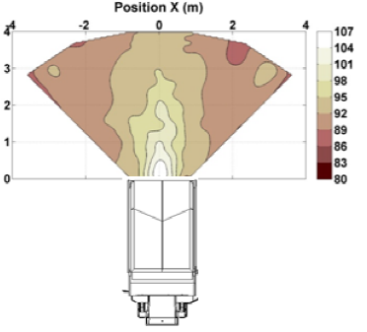
Sound Propagation Comparison
Tonal
Broadband
Nelisse, ET AL, (2011).

Slide 15
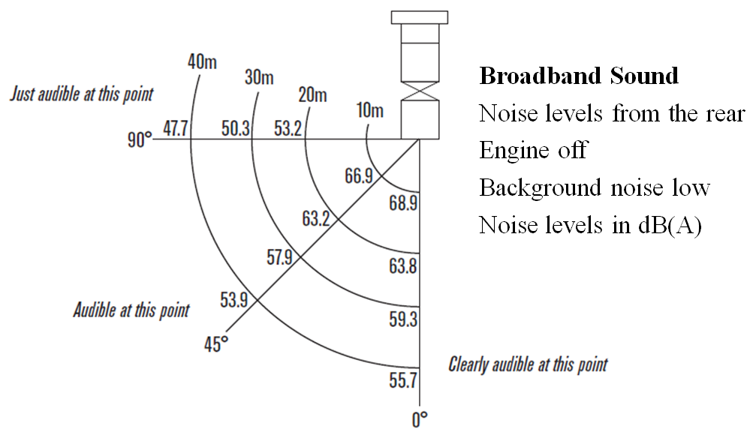
Axis Sound Dissipation
Dissipation off-axis. Reprinted from “Broadband sound; The safer and noiseless* back-up alarm” by Brigade Electronics, 2009, p. 8. Copyright 2009 by Brigade Electronics.

Slide 16
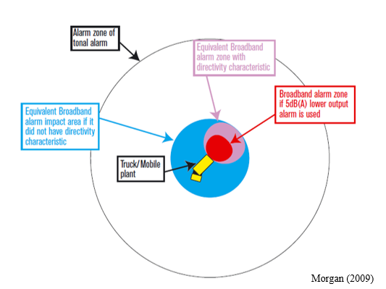
Broadband Alarm Net Effect
Reprinted from “Broadband sound; The safer and noiseless* back-up alarm” by Brigade Electronics, 2009, p. 10. Copyright 2009 by Brigade Electronics.

Slide 17
Research

Slide 18
Study Significance
Tonal alarms are ‘common’ solutions to reversing compliance.
Tonal alarms are typically perceived as non-directional area wide reverse announcements that create significant noise pollution
Studies have determined broadband alarms are a superior solution based on audibility, propagation, frequency content, and sound pressure maps.
No scientific studies regarding perceptions of broadband alarm benefits.

Slide 19
Sample Population
Occupational pedestrians, forklift operators, maintenance employees and location leaders working for one business segment of one global steel organization:
49 locations
1,211 employees were surveyed

Slide 20
Major Finding
Reversing Alarm Benefit Traits
only heard when the equipment is near
I can tell the equipment’s direction of travel without seeing it
the backup alarm becomes louder or softer depending on other background noises
Individuals with hearing loss can hear the alarm
I can tell where the mobile equipment is without looking
the backup alarm is hard to ignore, I can’t tune it out
other plant shop noise does not hide or interfere with the backup alarm
I am not frightened when I suddenly hear the alarm

Slide 21
Major Findings
Reversing Alarm Benefit Traits
61% of the respondents associated the listed traits with broadband reversing alarms.
33% of the respondents associated the listed traits with tonal reversing alarms.
6% of the responses associated the listed traits with either alarm type of both alarm types.

Slide 22
Summary
Improved safety / reduced risk of backover events.
Reduced risk of long term hearing damage.
Eliminate noise (environmental) issues.
Improved alarm audibility using hearing protection
Improved alarm audibility with high frequency hearing loss

Slide 23
Backup Alarms Case to Change from Tonal to Broadband
Socrates: “Treatment without diagnosis is malpractice”
Beepers inform of a truck backing somewhere… … not of an approaching hazard !
beepers are acoustically deficient
Presentation; Diagnosis (accidents & function), Options, Summary

Slide 24
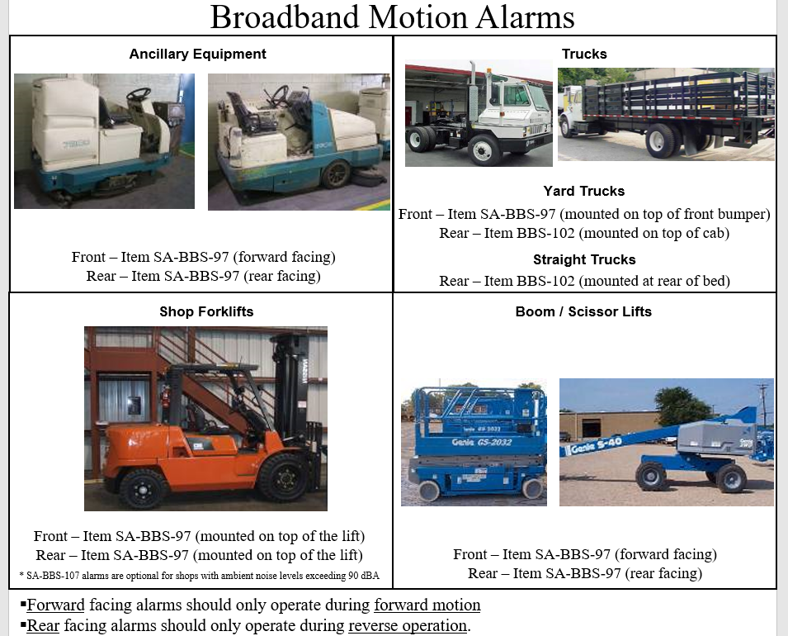
Pilot Program

Slide 26
Questions

